Slide 1

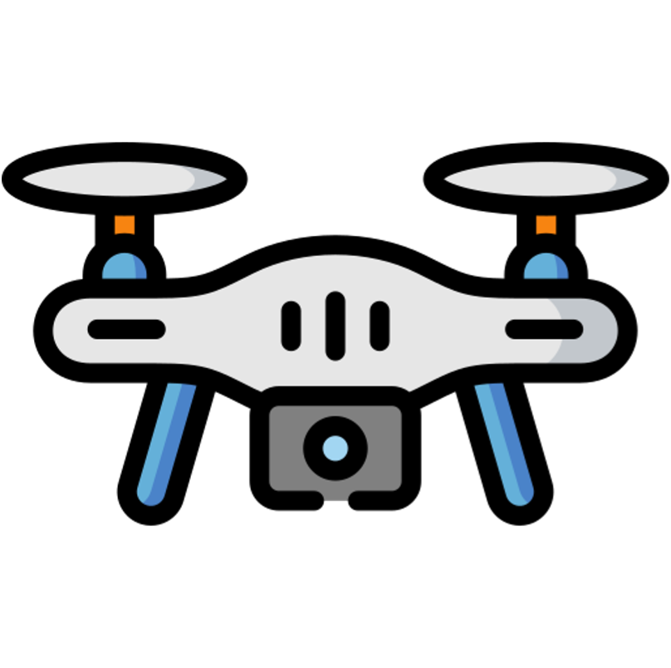


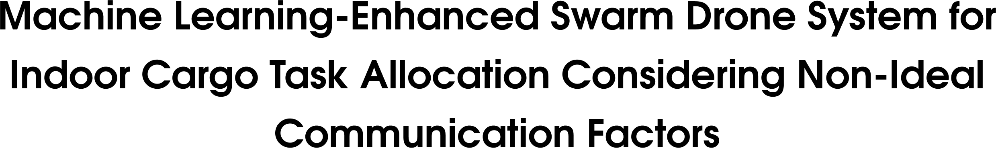

Ege CargoWings
Disclaimer
This project is still in progress and certain parts
of it may undergo changes during the development process.
1

Slide 2
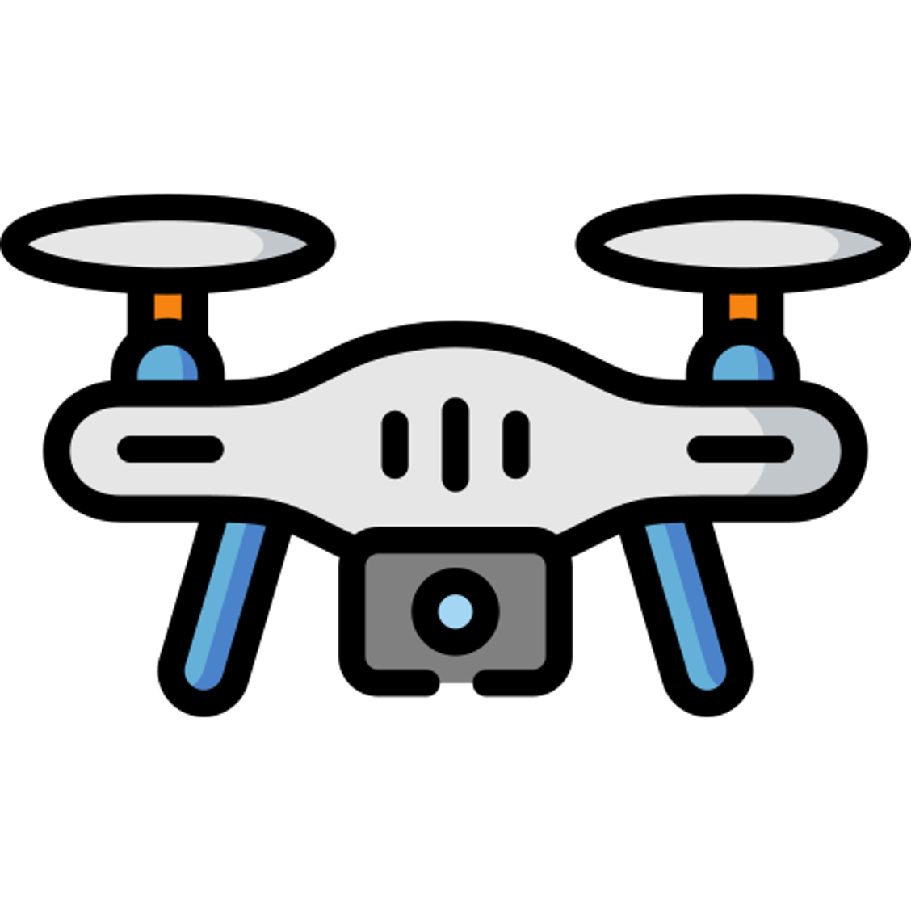
Objective
The objective of this graduation project is to design and implement an indoor cargo delivery system using a swarm of drones.
This system will leverage machine learning algorithms to optimize task allocation among the drones while taking into account non-ideal communication factors that are commonly encountered in indoor environments.
Moreover, we will incorporate computer vision capabilities to handle critical tasks such as obstacle avoidance and emergency situation detection.
1
2
3

Slide 3
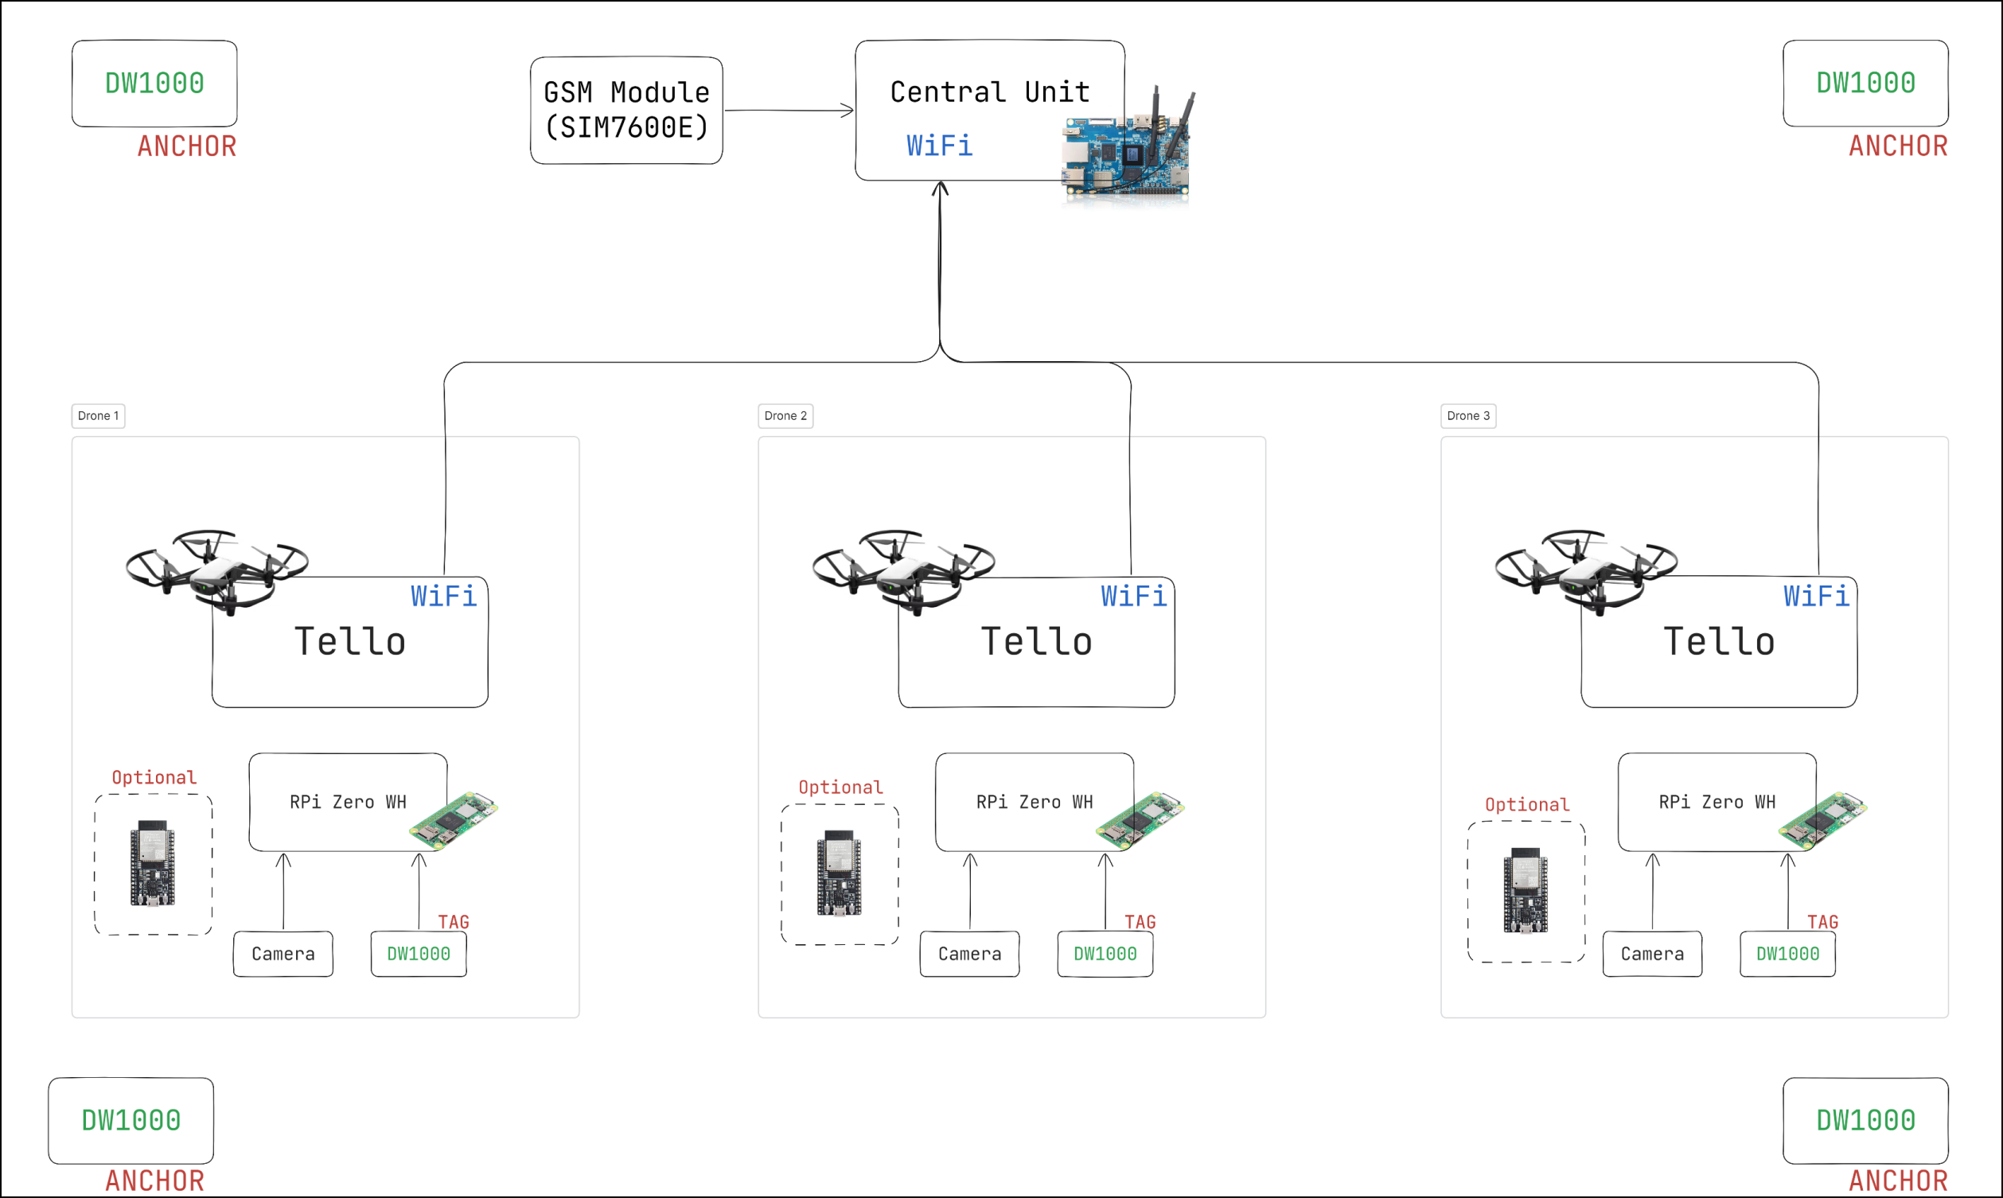
System Architecture (Hardware)
3

Slide 4
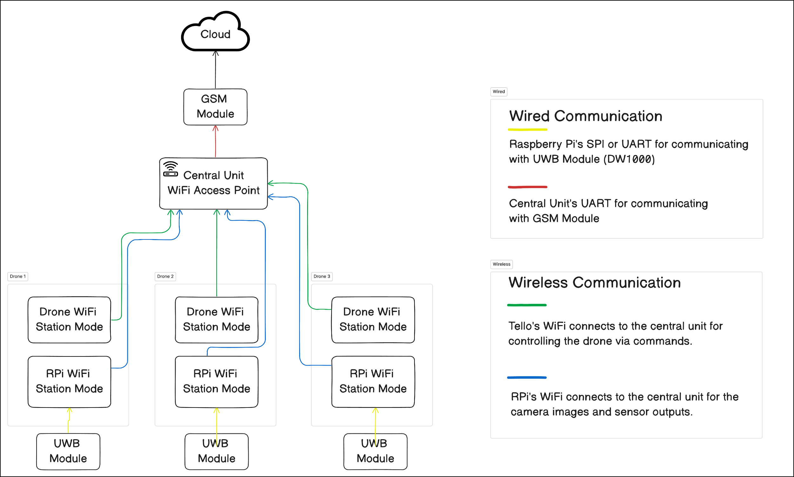
Network Architecture (Wired & Wireless)
4

Slide 5
Required Components
5

Slide 6
Questions
Why did you choose DJI Tello ?
Why did you put the Raspberry Pi Zero on top of that drone?
and why did you choose the Orange Pi5 B for the central unit?
Why not use GPS for position information?
How do you plan to integrate machine learning algorithms
into the system?
Why do you have ESP32 optionally in the system design part?
6

Slide 7
Ege CargoWings
Thank You
7

